Slide 1
Summer Internship Mid-term Presentation
Naveed Ziari
19 July 2022
Clinical Data Science

Slide 2
Project Rules/Setup

Slide 3
Each subject given a drug with measurements of:
mRNA levels (expression) of ~800 genes
Viability/response of 100 cell lines
3 categorical features
Treatment duration
Control vs treatment group
Dosage (high vs. low)
For the training set, mechanism of action (MoA) targets are annotated
Predict the MoA of the drug on each subject in the test set
Scored using a negative logarithmic loss function
Multi-Label Classification
Problem Statement

Slide 4
Data Format
Training/Test Features:
observations
categorical features
gene expression
cell viability
sig_id | ctrl/trt | dose | duration | g-1 | g-… | g-800 | c-1 | c-… | c-100
id_000644bb2 | Trt | D1 | 24 | -1.022 | -0.0326 | 0.5548 | 0.0495 | 0.4141 | 0.8432
id_000779bfc | Trt | D1 | 48 | 0.2341 | 0.3372 | -0.4047 | 0.7639 | 0.5499 | -0.3322
id_000a6266a | Trt | D2 | 72 | 0.1715 | 0.2155 | 0.0065 | 0.976 | -0.0427 | -0.1235
id_0015fd391 | ctrl | D1 | 24 | -1.959 | 0.1792 | -0.1321 | -1.081 | -3.052 | -3.447
Targets:
Drug information:
observations
MoA targets
observations
drug administered
sig_id | MoA-1 | MoA-… | MoA-206
id_006fc47b8 | 0 | 1 | 0
id_0071d65a2 | 1 | 0 | 0
id_007a2159c | 0 | 0 | 1
sig_id | drug_id
id_0023f063e | de7583071
id_002452c7e | 89dea2045
id_0024bcd70 | b877aa048

Slide 5
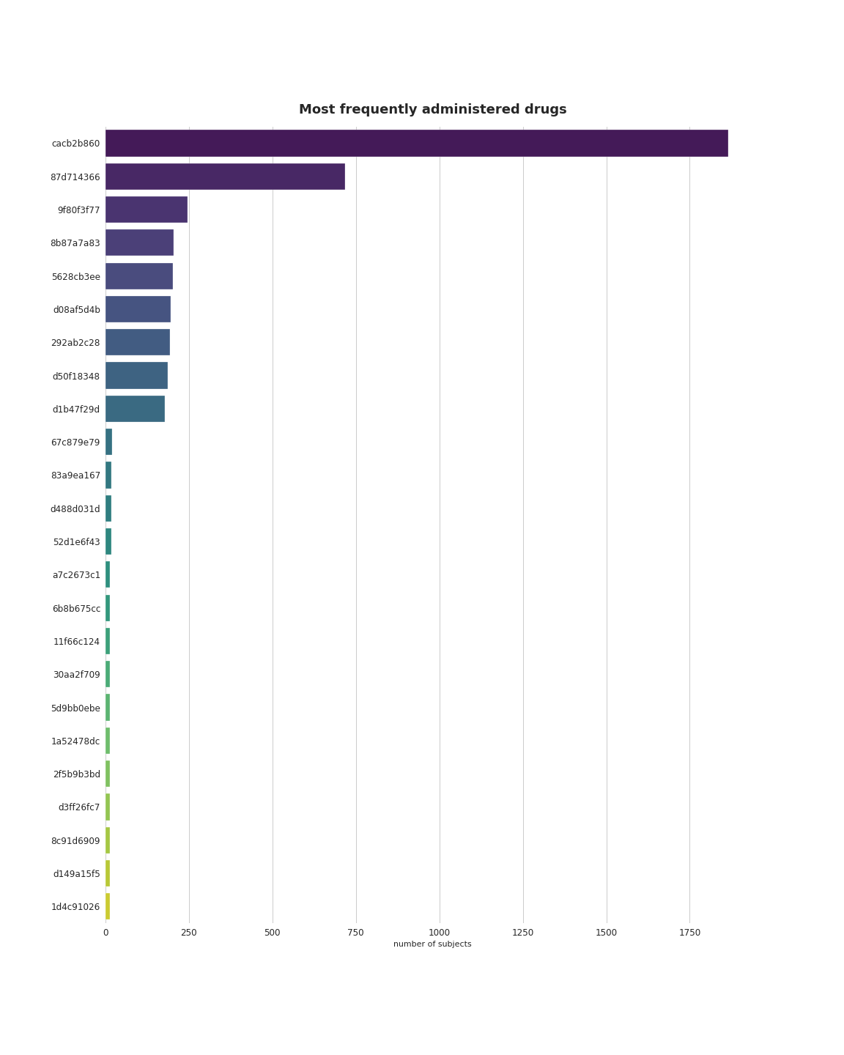
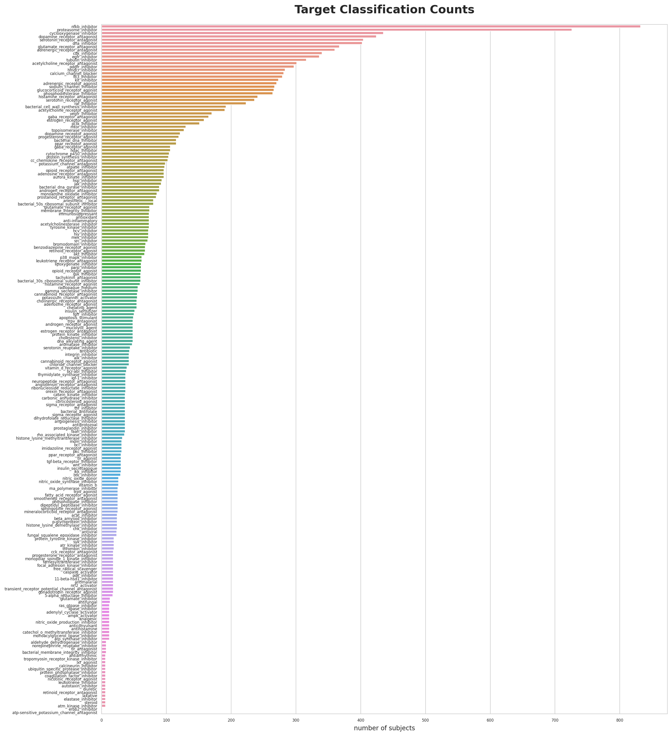
Size of Dataset
Training set
23814 subjects
3289 drugs
206 mechanisms of action
No missing data
Test set
3982 subjects

Slide 6
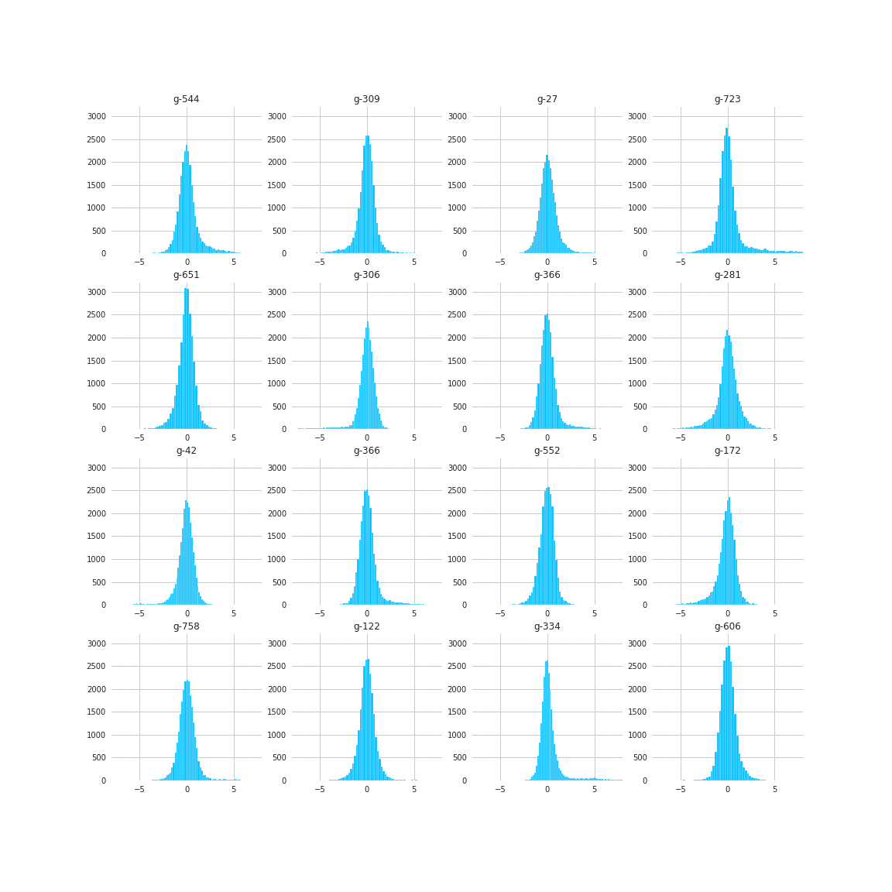
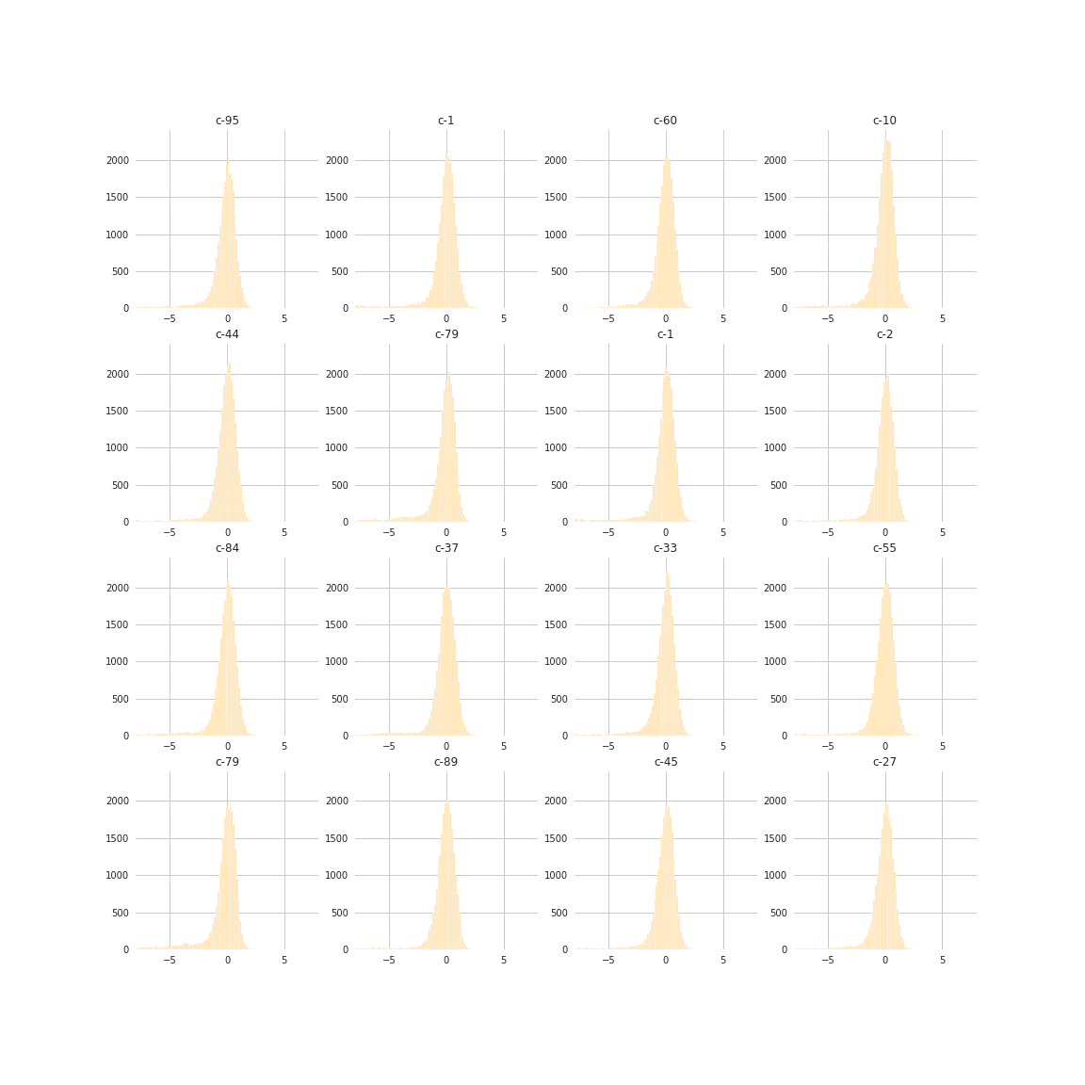
Data is Z-scored with zero mean
Transformation (Rank Gauss)?

Slide 7
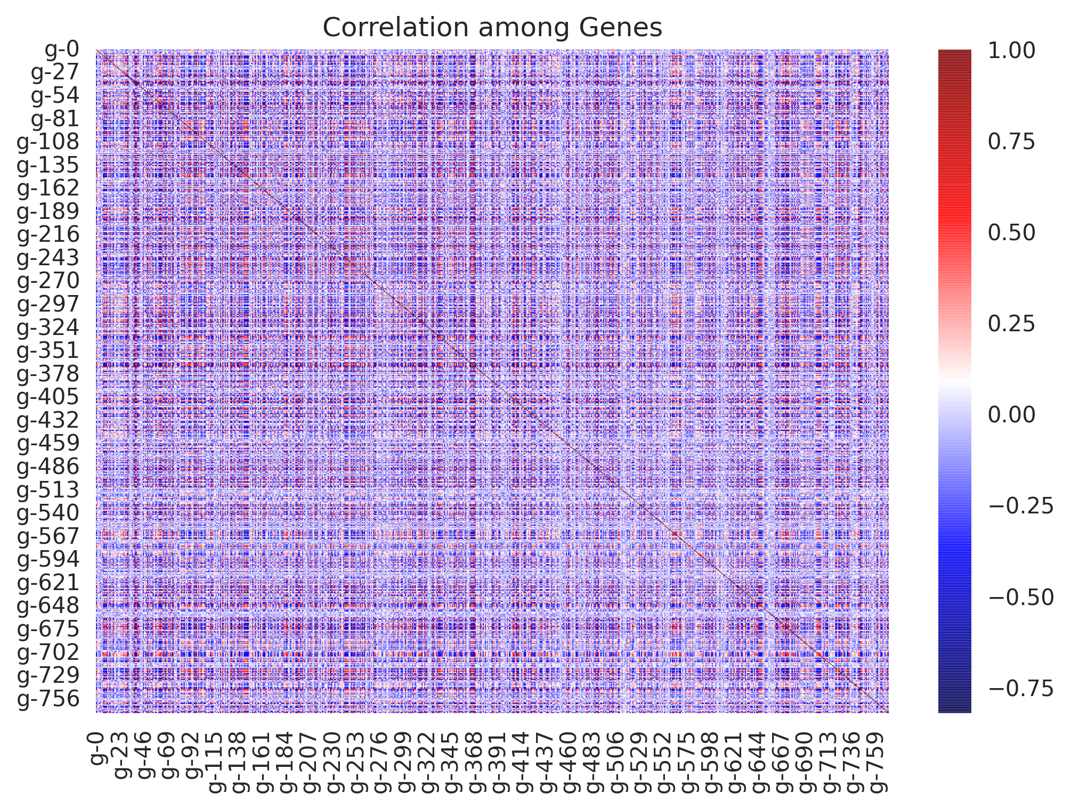
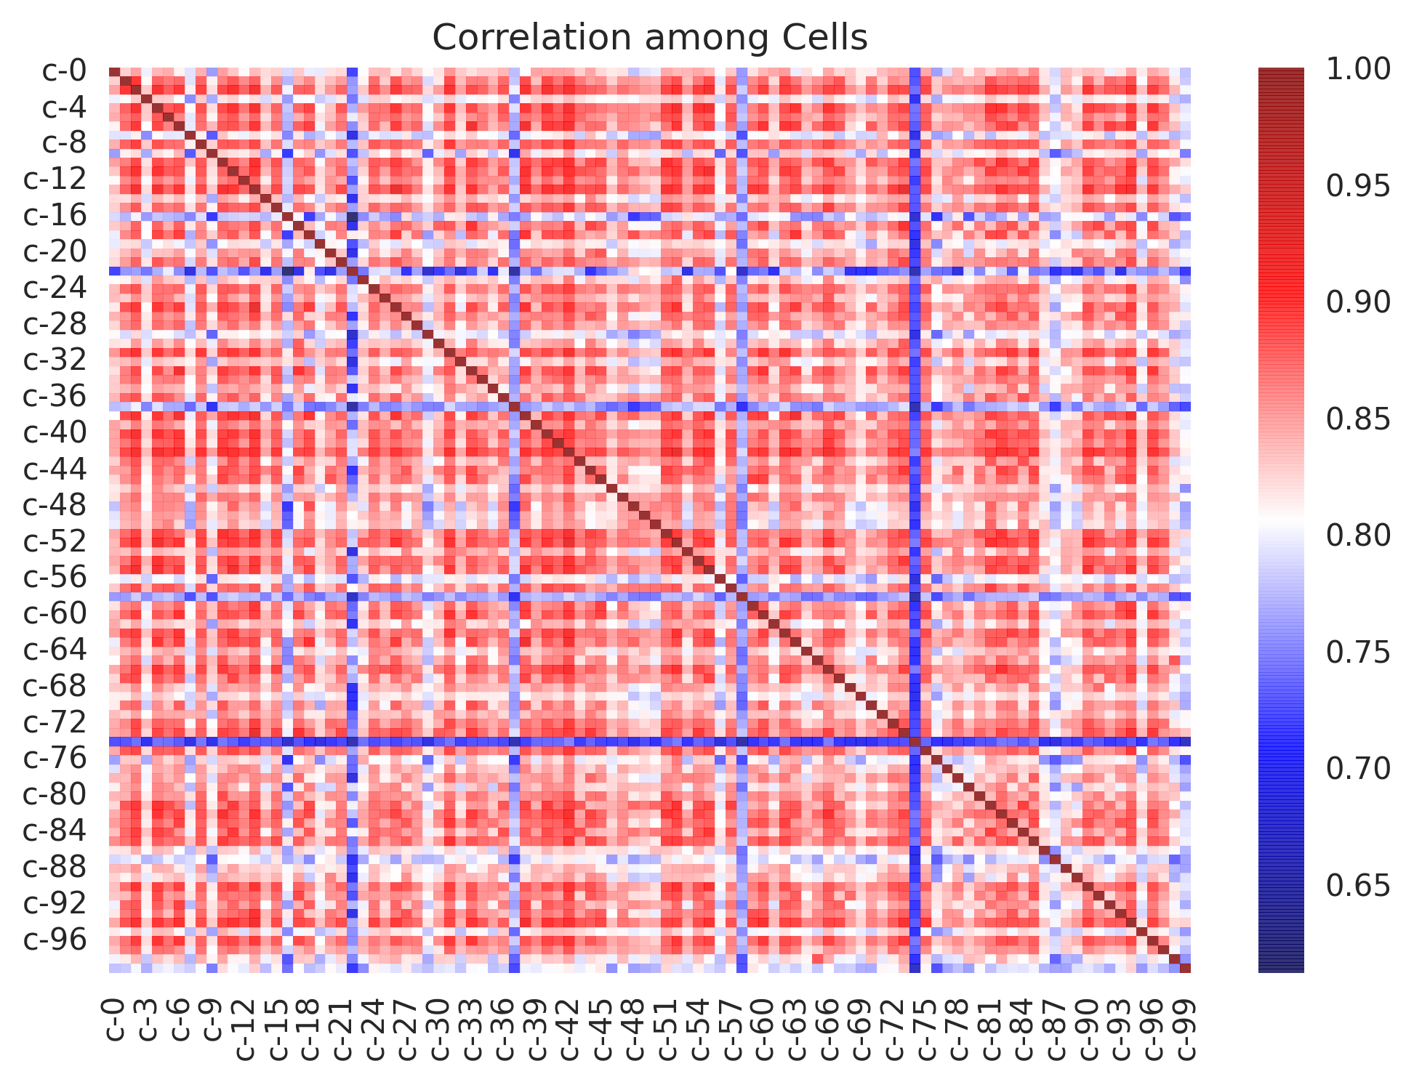
Not much correlation among genes
High correlation among cells
Notes:
Heirarchical clustering of cells

Slide 8
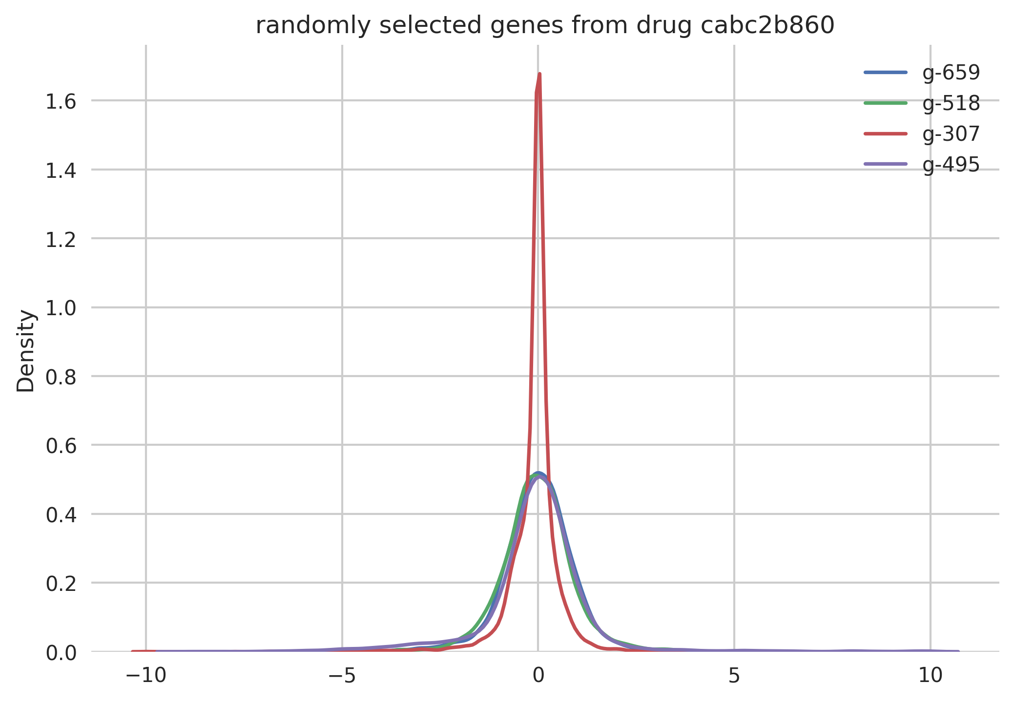
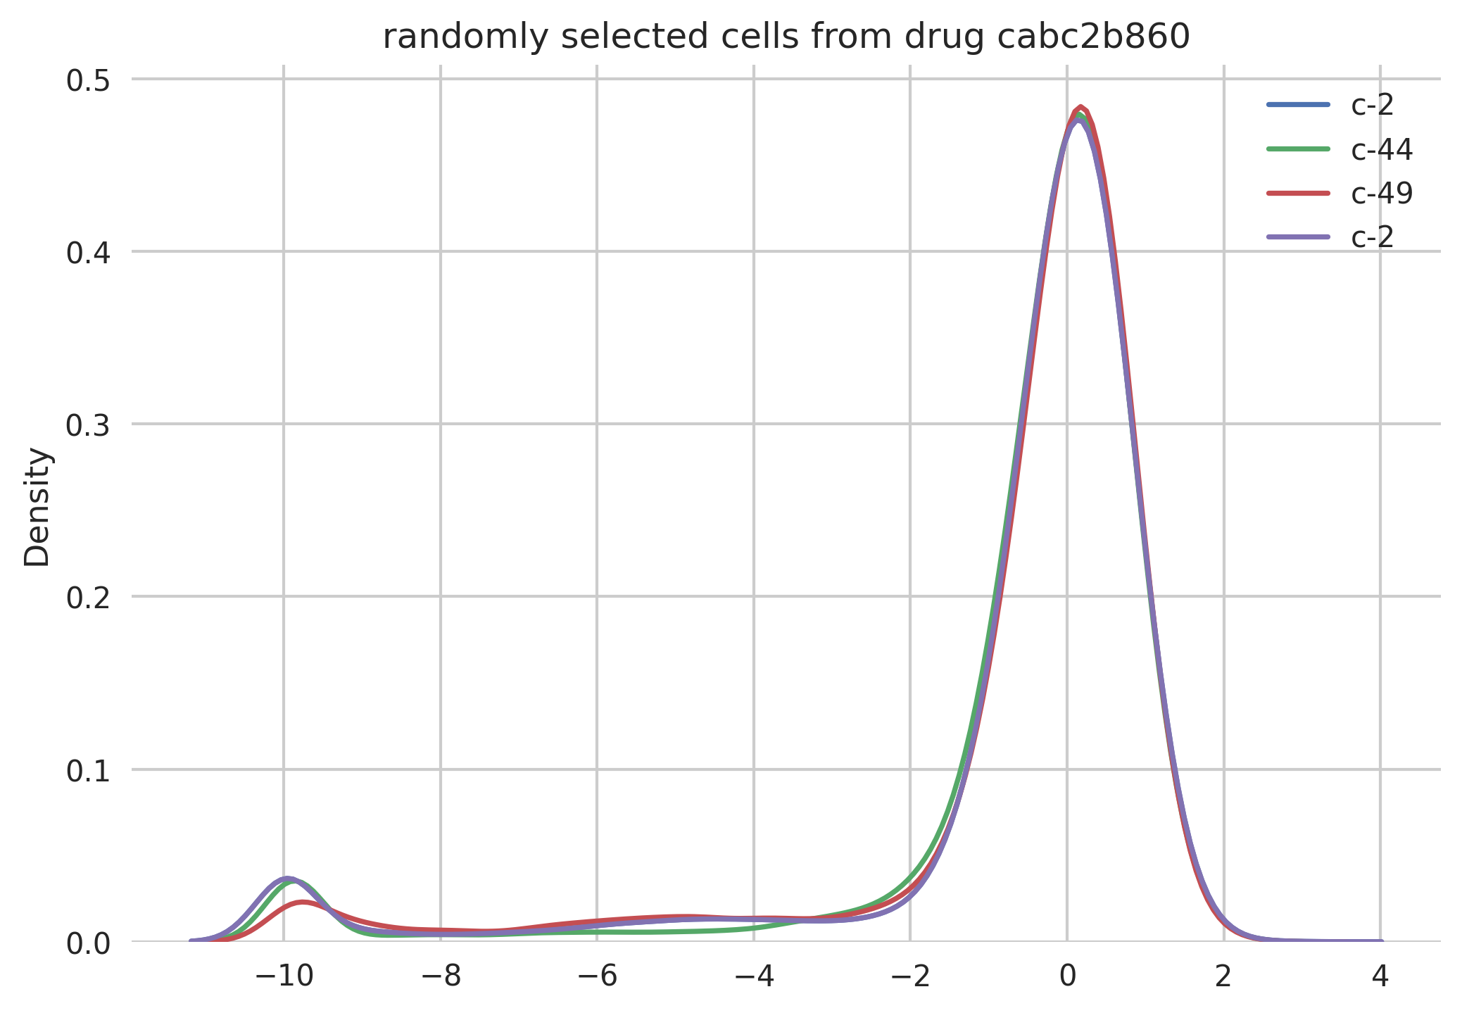
Overall no response to drug?
Slight effect on cell viability

Slide 9
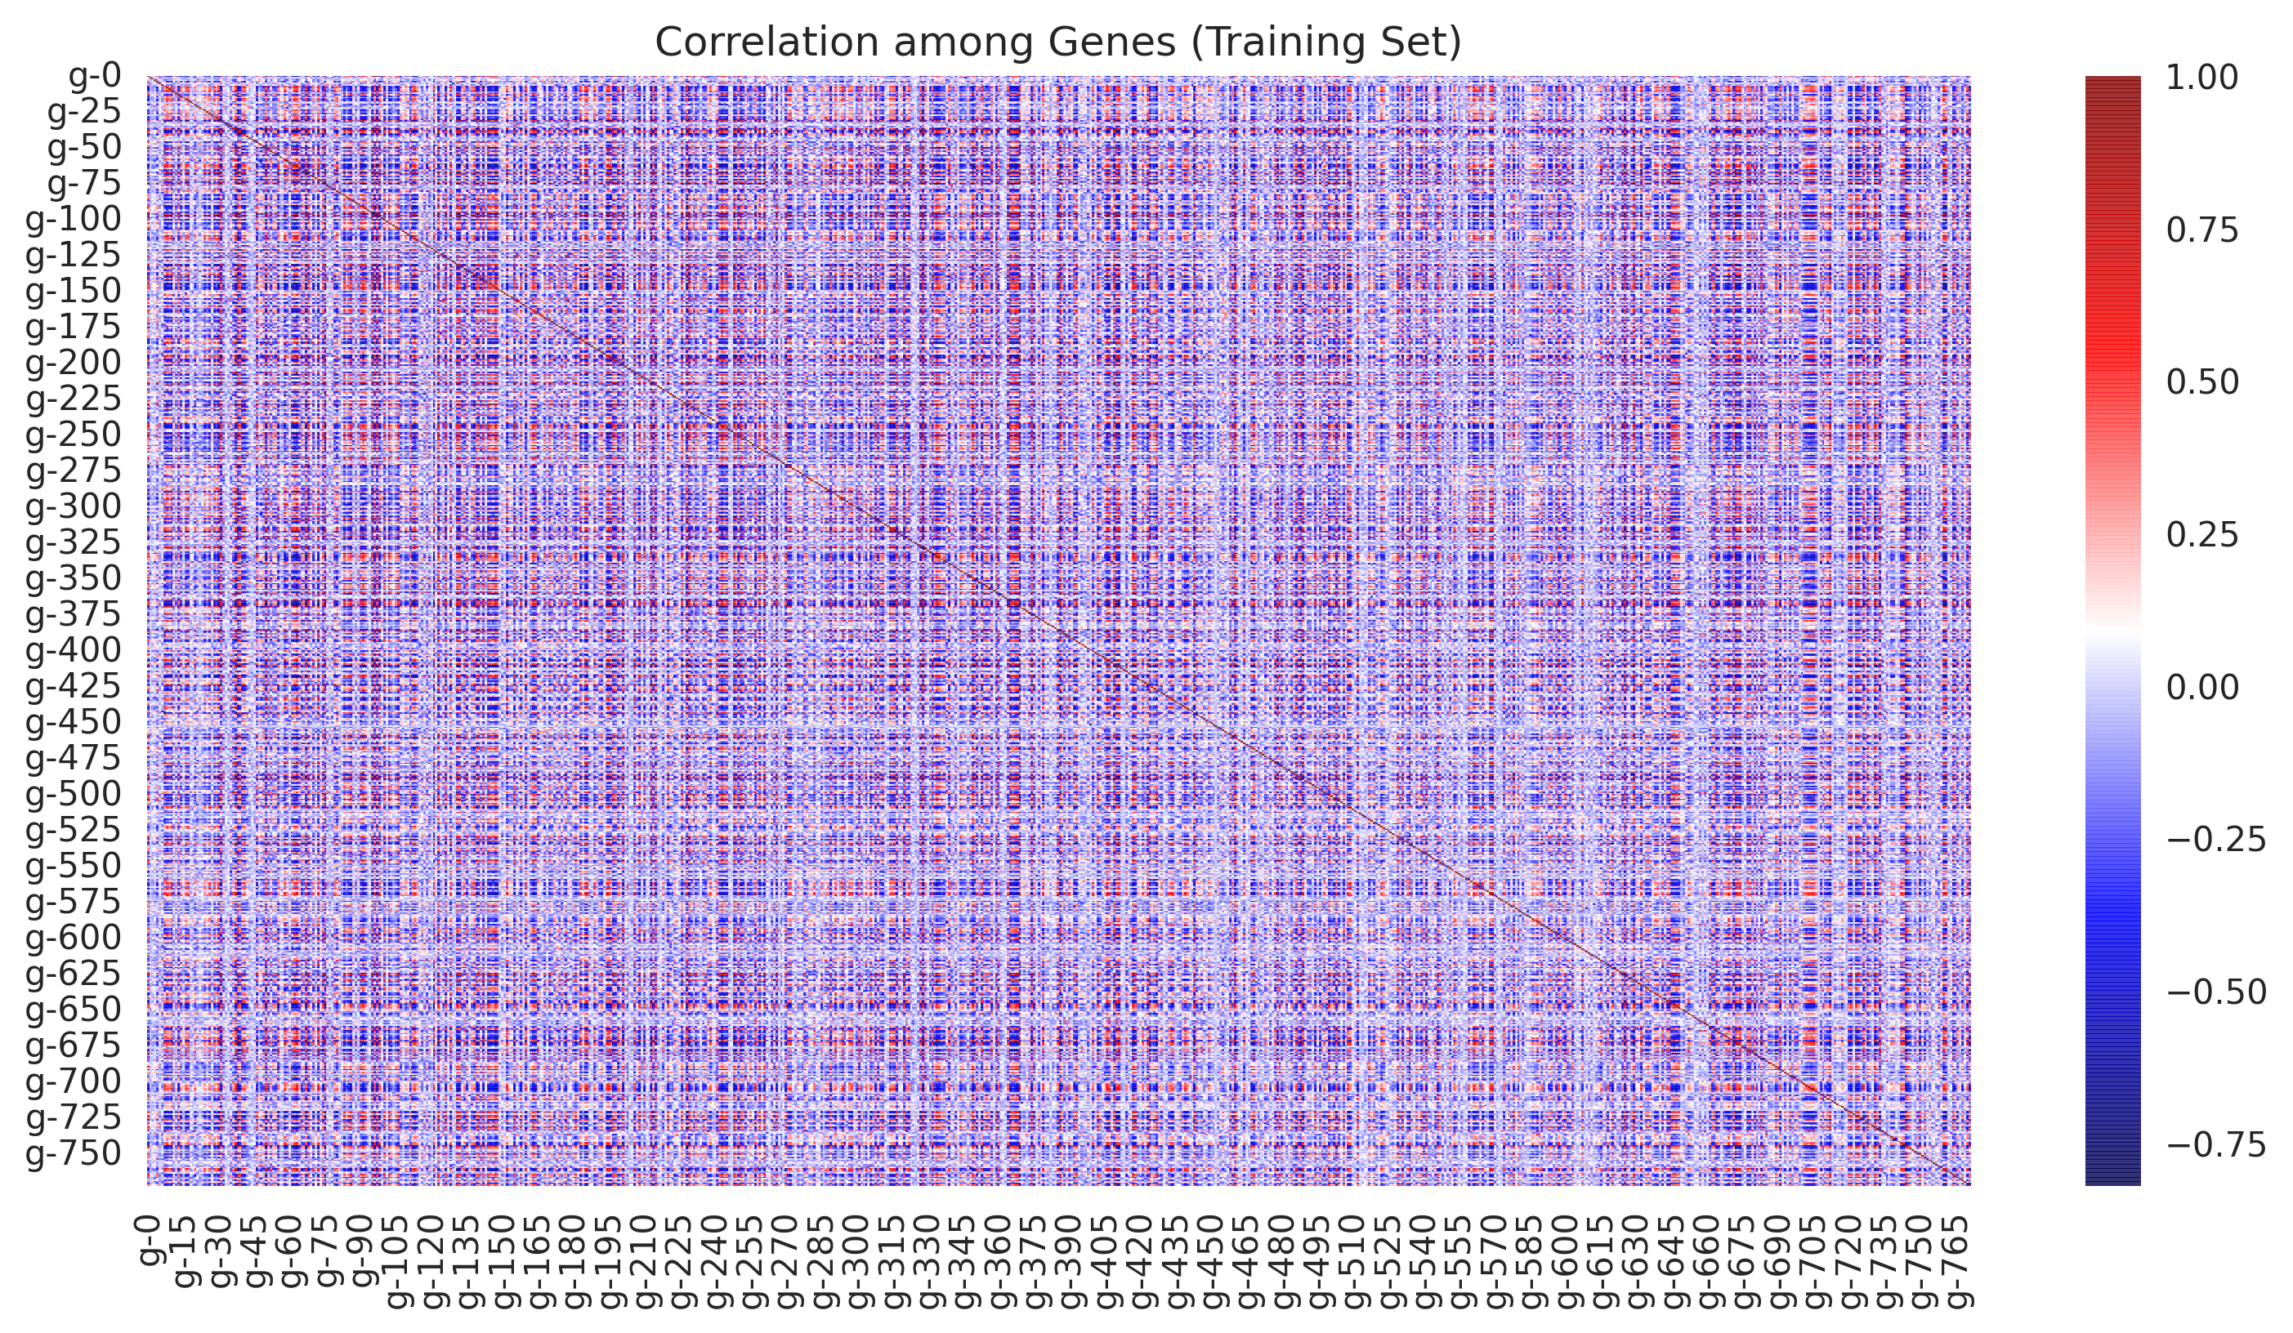
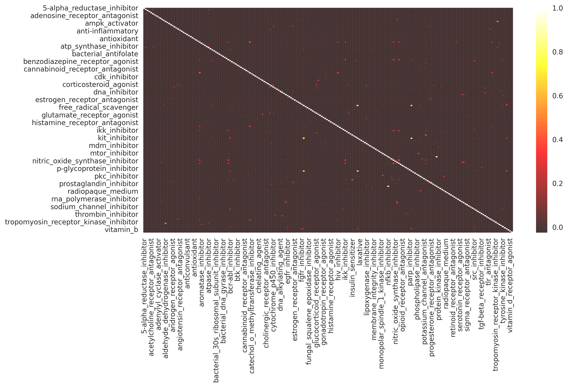

Not much correlation between targets

Slide 10
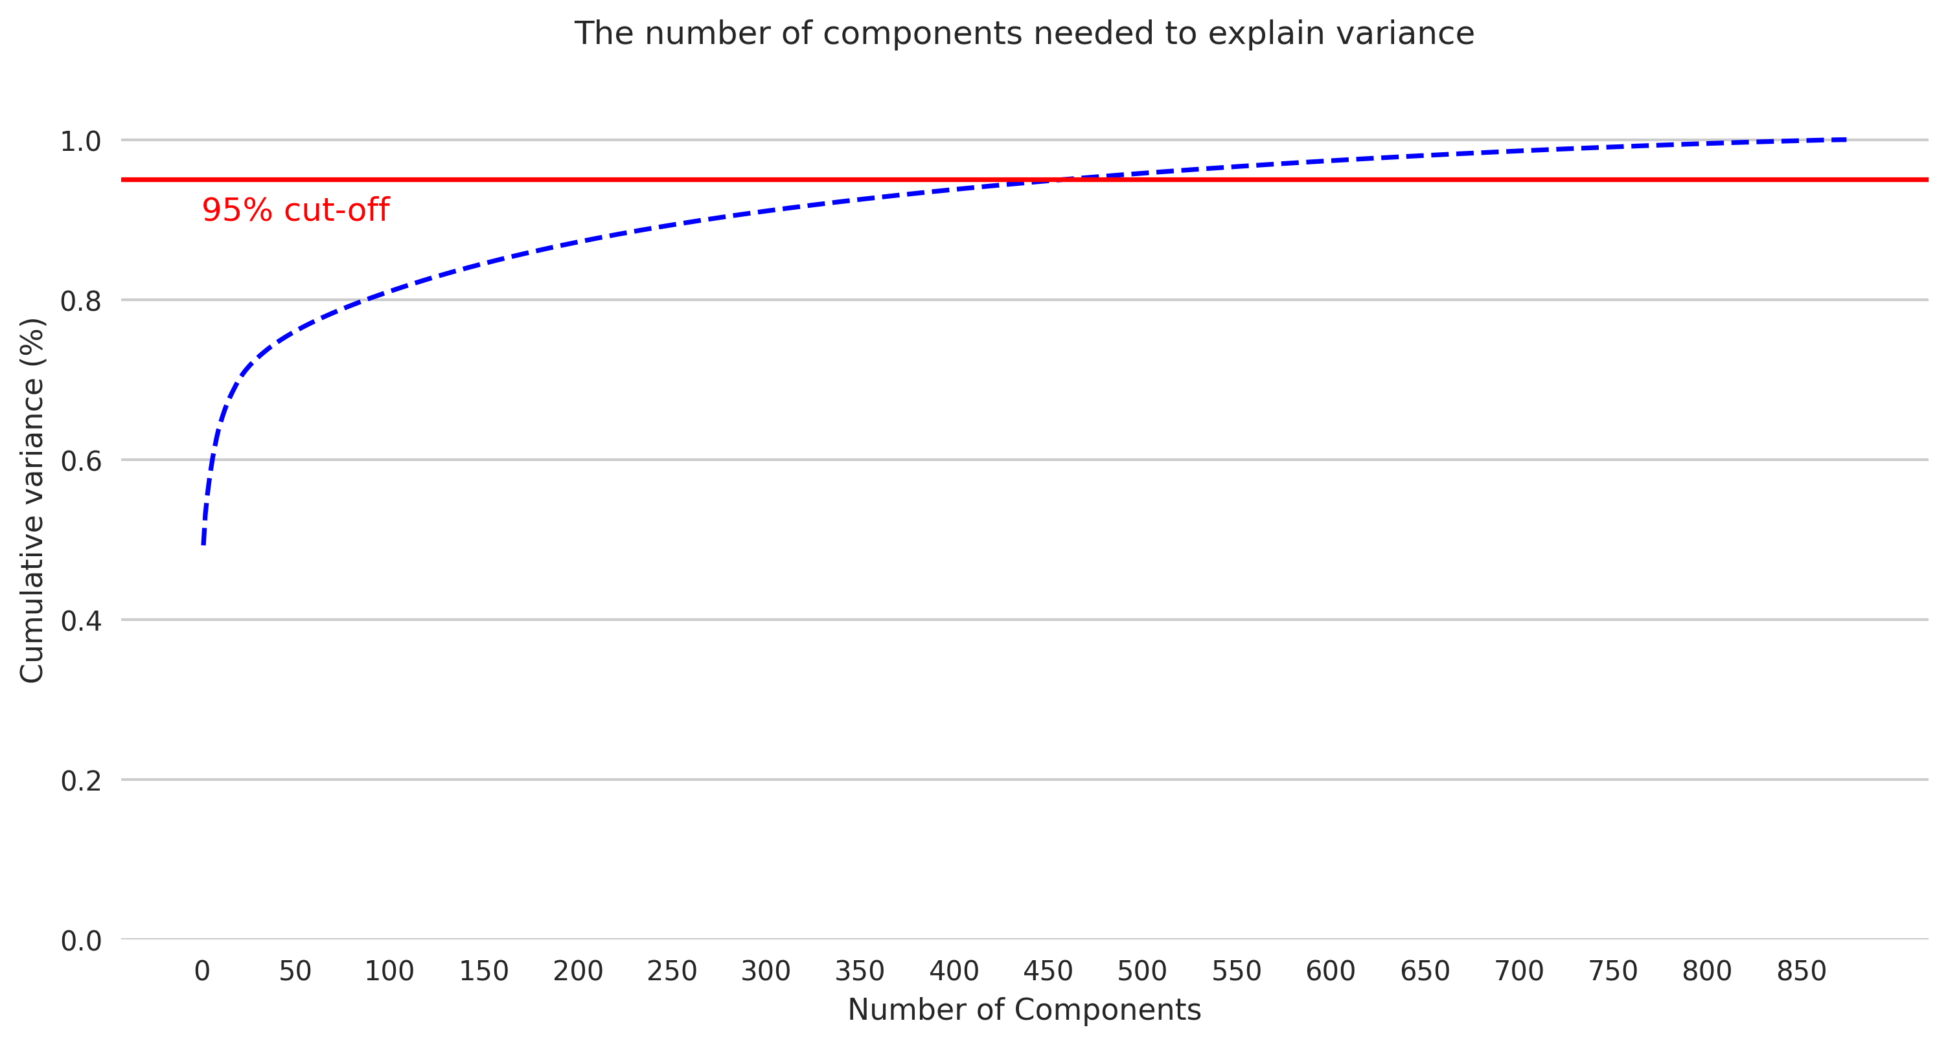
Dimensionality Reduction/Feature Extraction
Representation of high-dimensional data in lower dimensions
Change of basis for inclusion of highest amount of variance
Using singular value decomposition
Helps in interpreting the data
Can include principal components as added features for training model

Slide 11
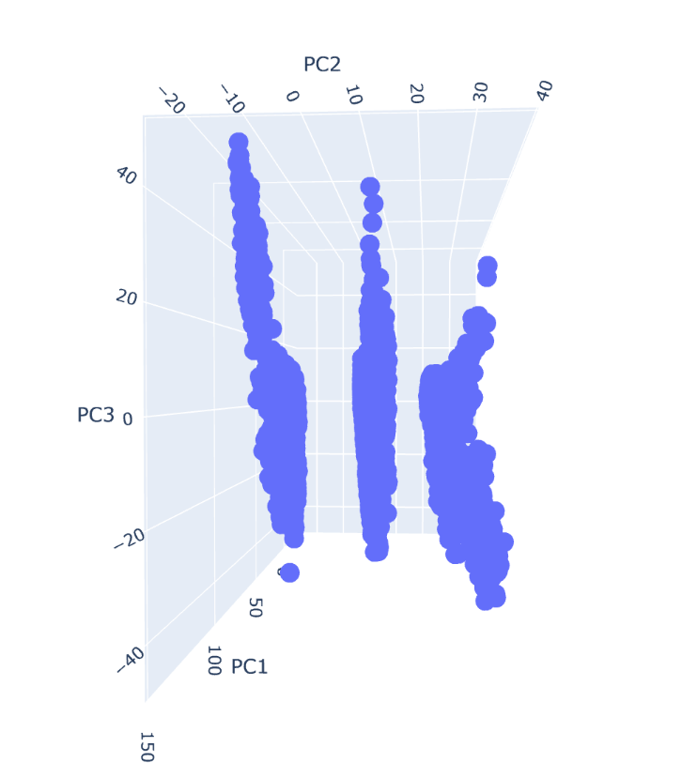
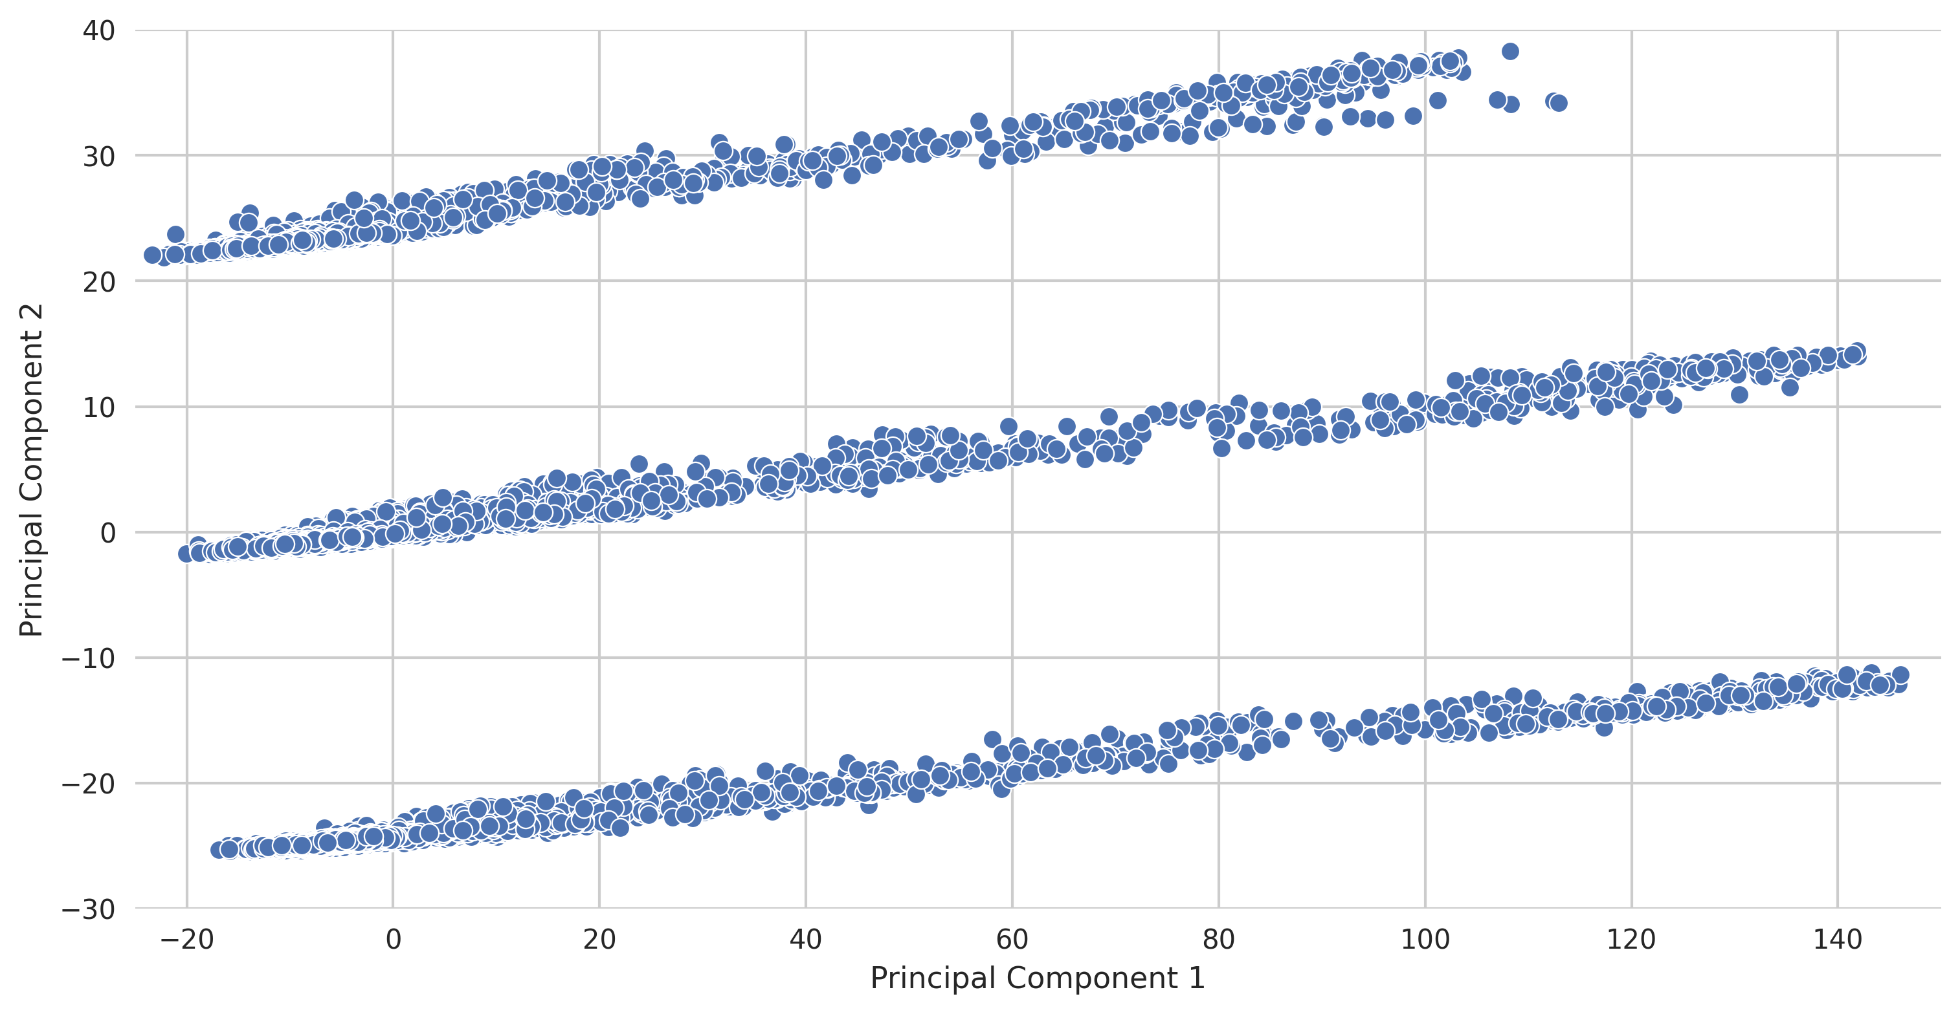
Dimensionality Reduction/Feature Extraction (cont.)

Slide 12
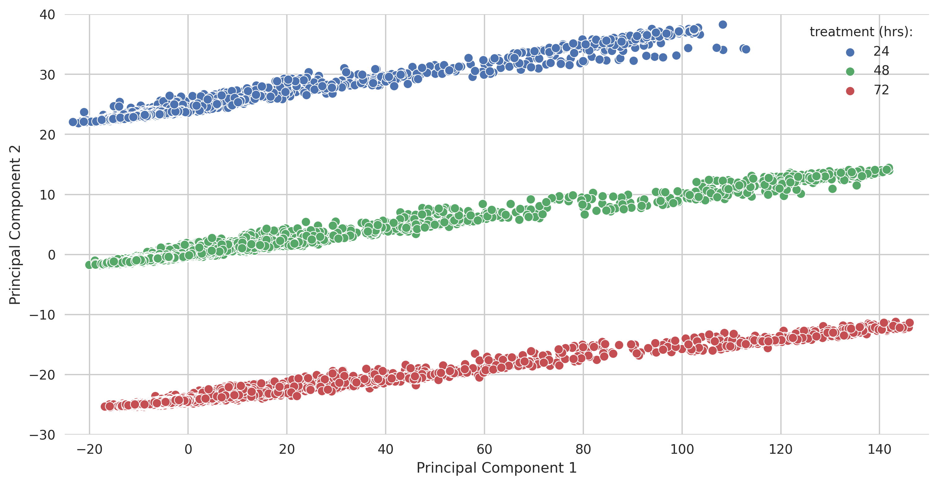
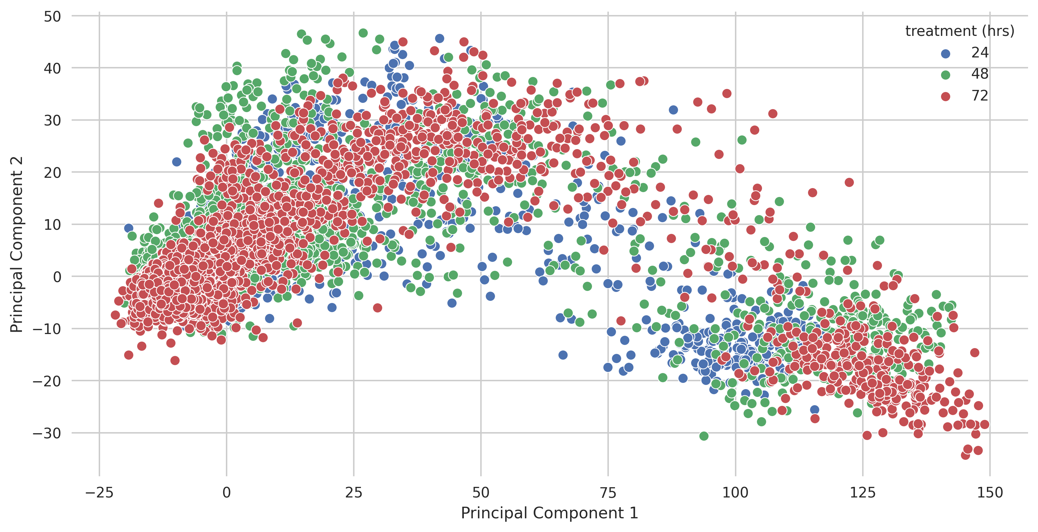
Dimensionality Reduction/Feature Extraction (cont.)
Magnitude of effect linear with treatment duration
Perform PCA with each treatment duration separately

Slide 13
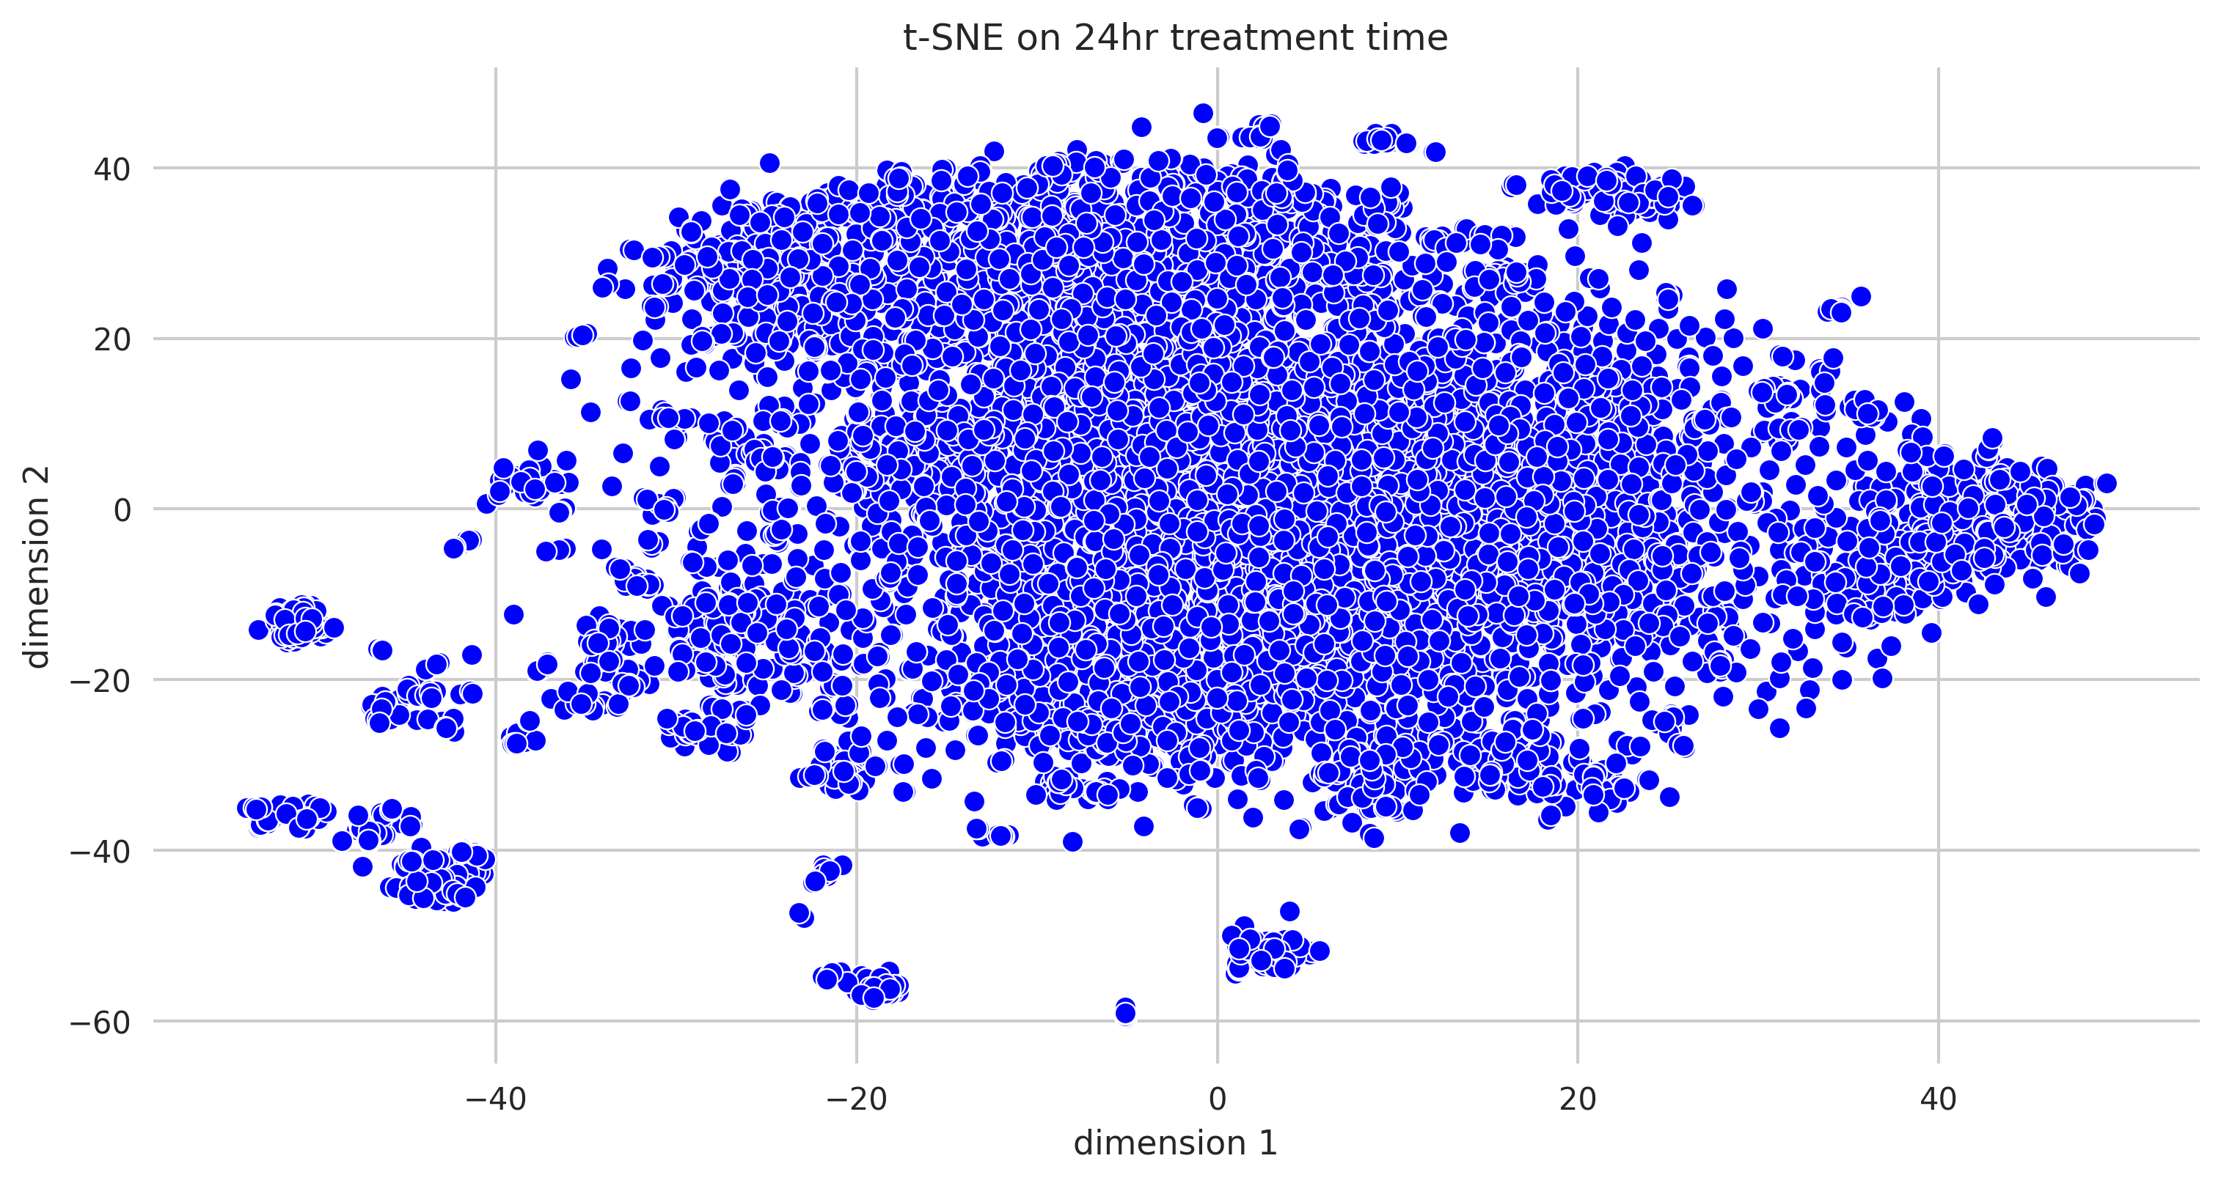
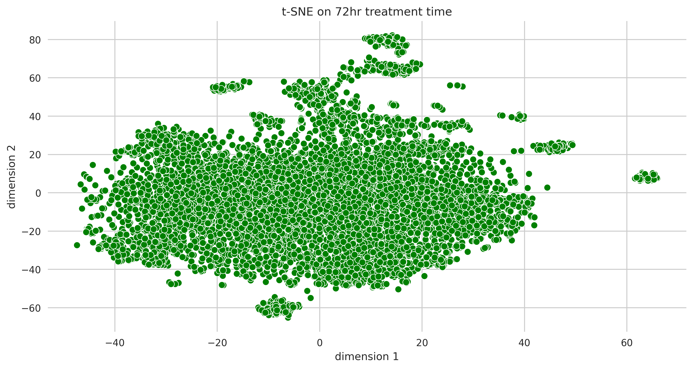
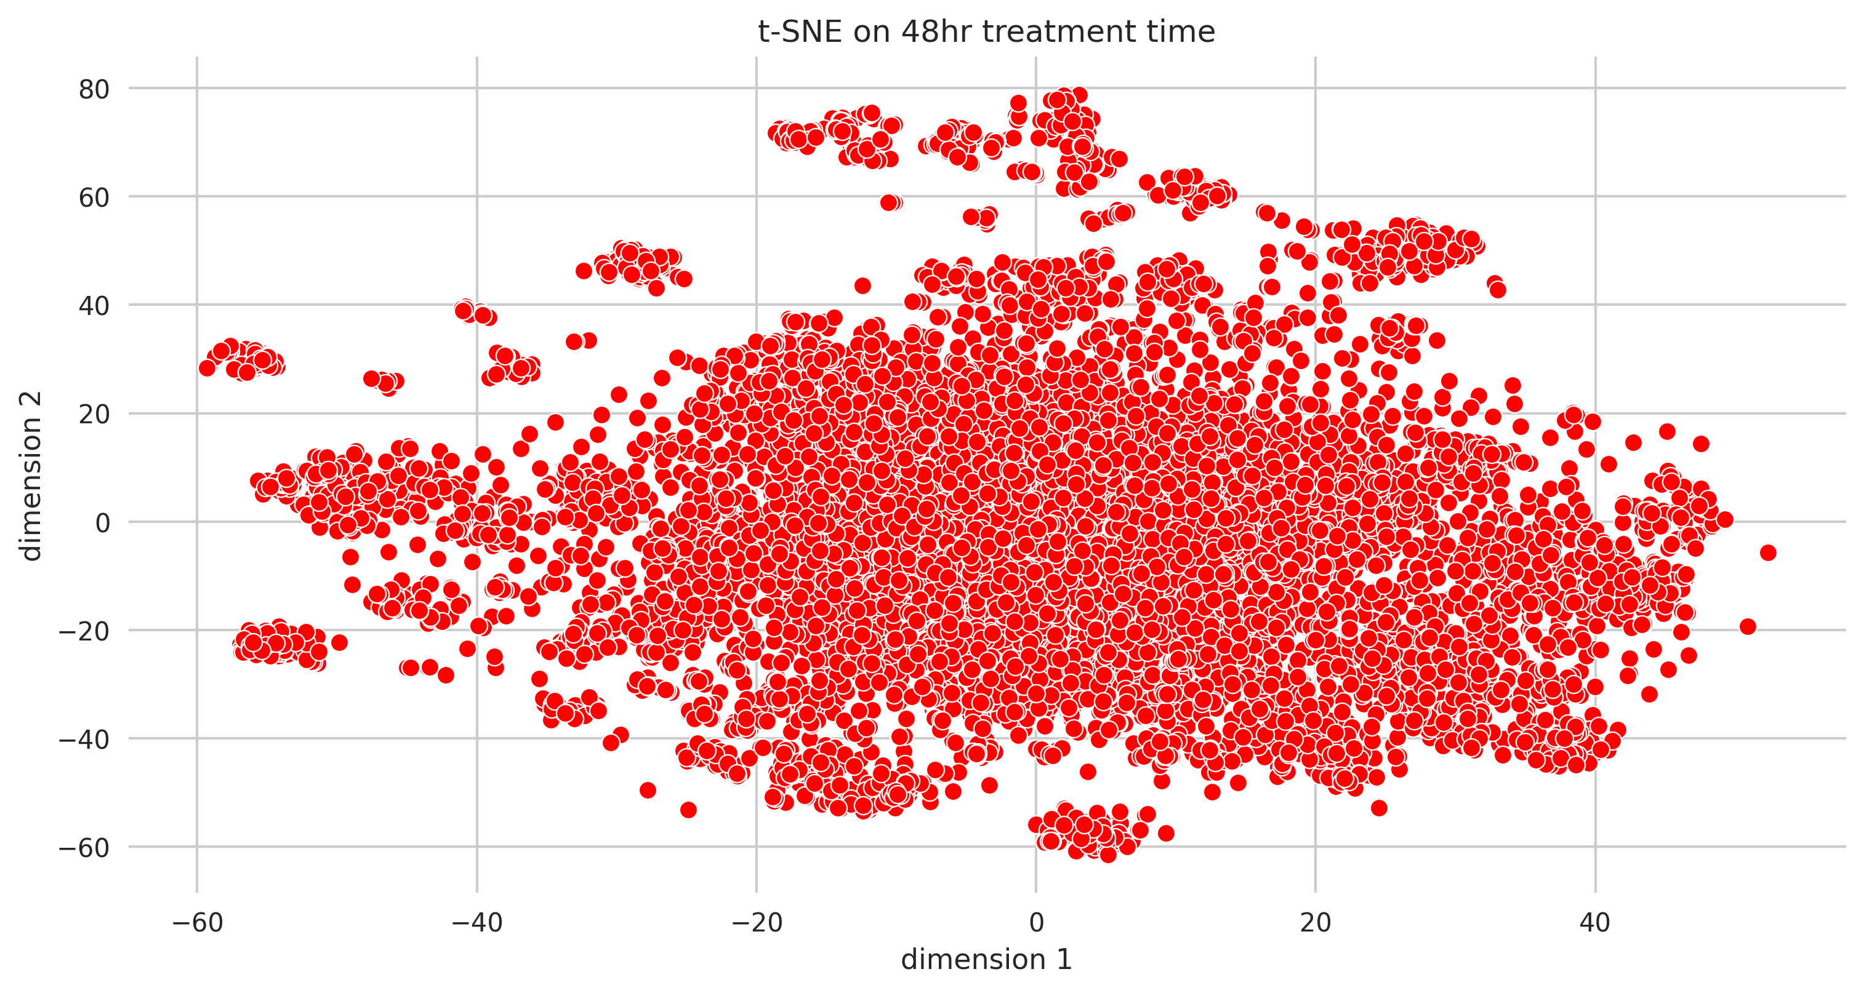
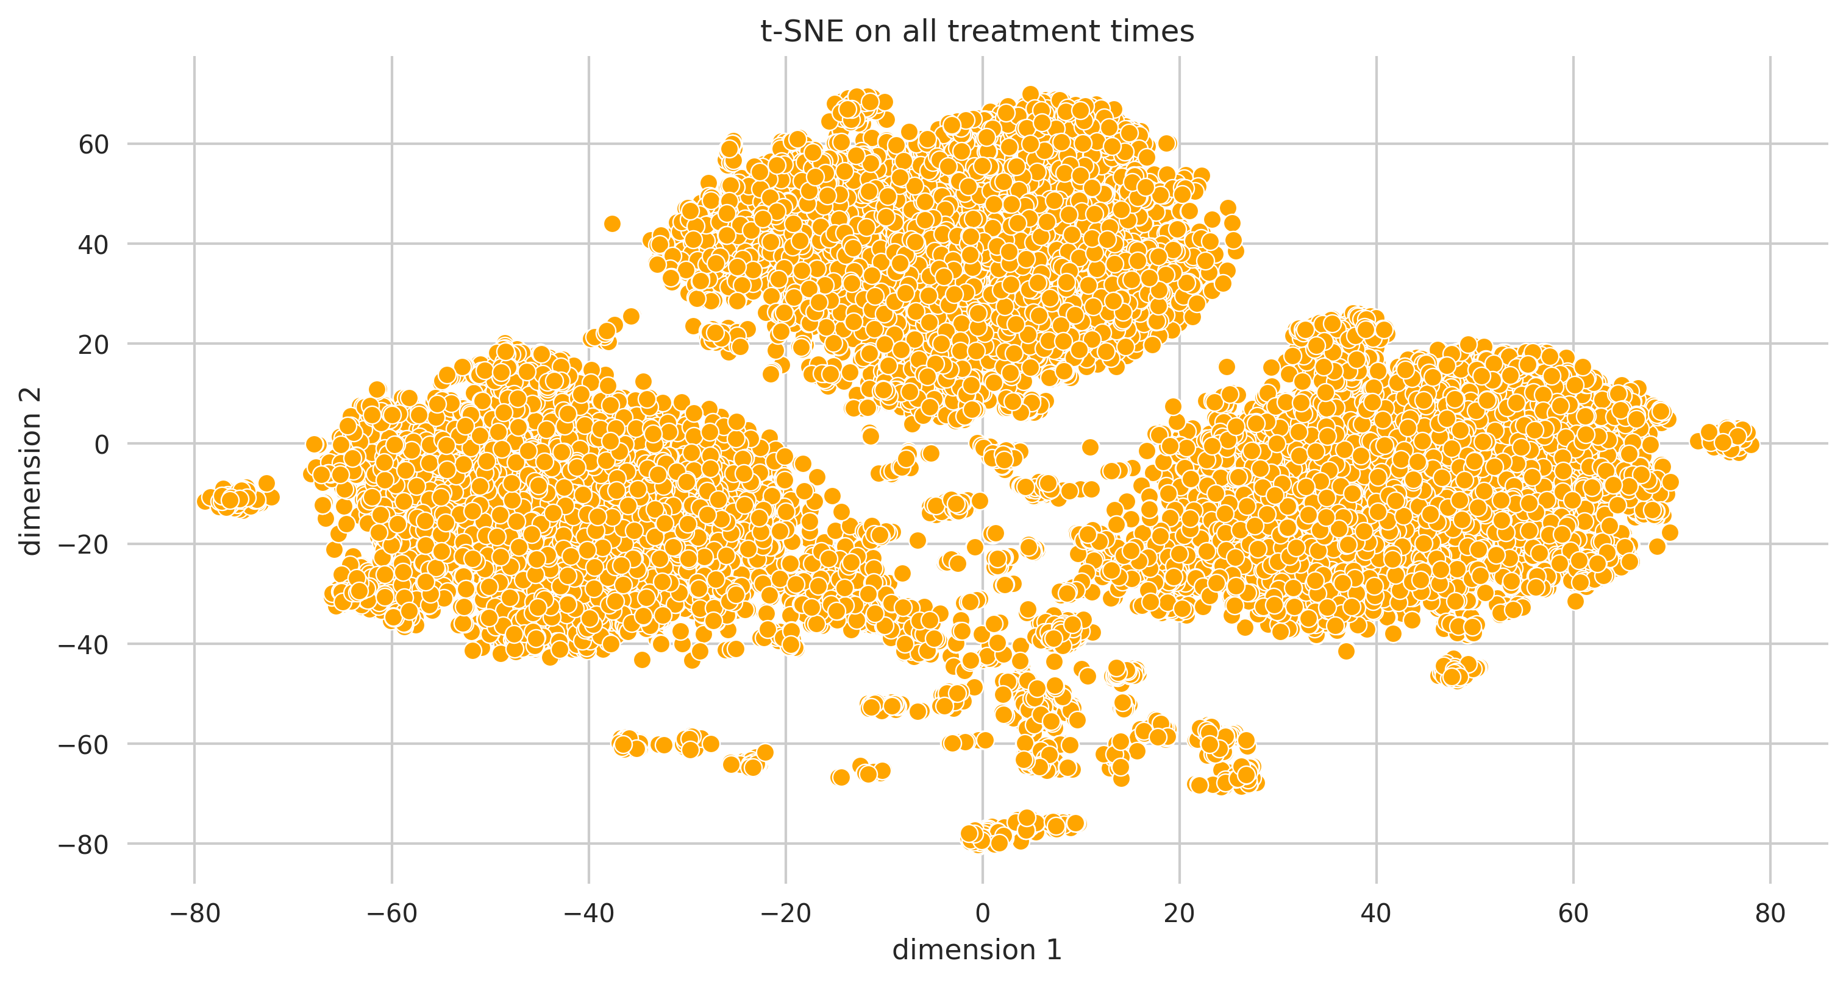
Dimensionality Reduction/Feature Extraction (cont.)
Still see clustering of treatment times using
non-linear dimensionality reduction (t-distributed
stochastic neighbor embedding)

Slide 14
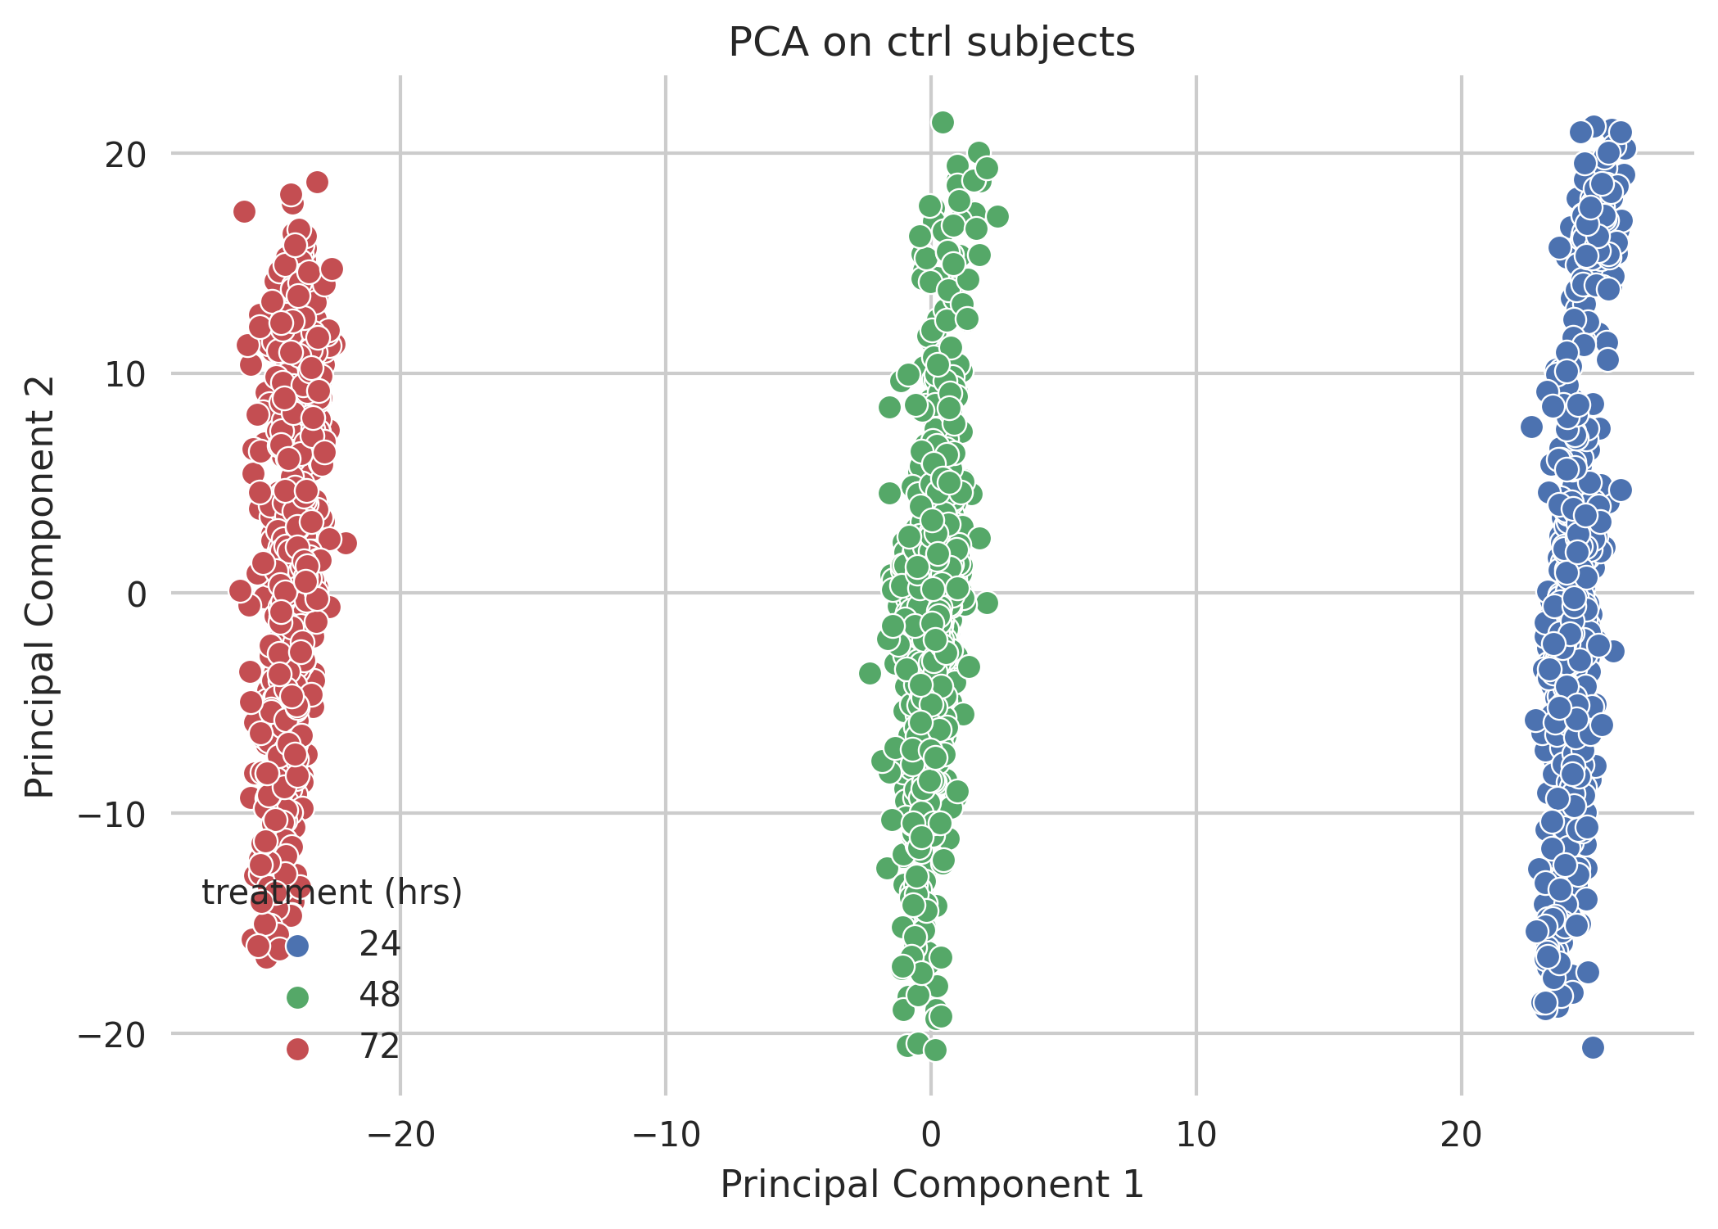
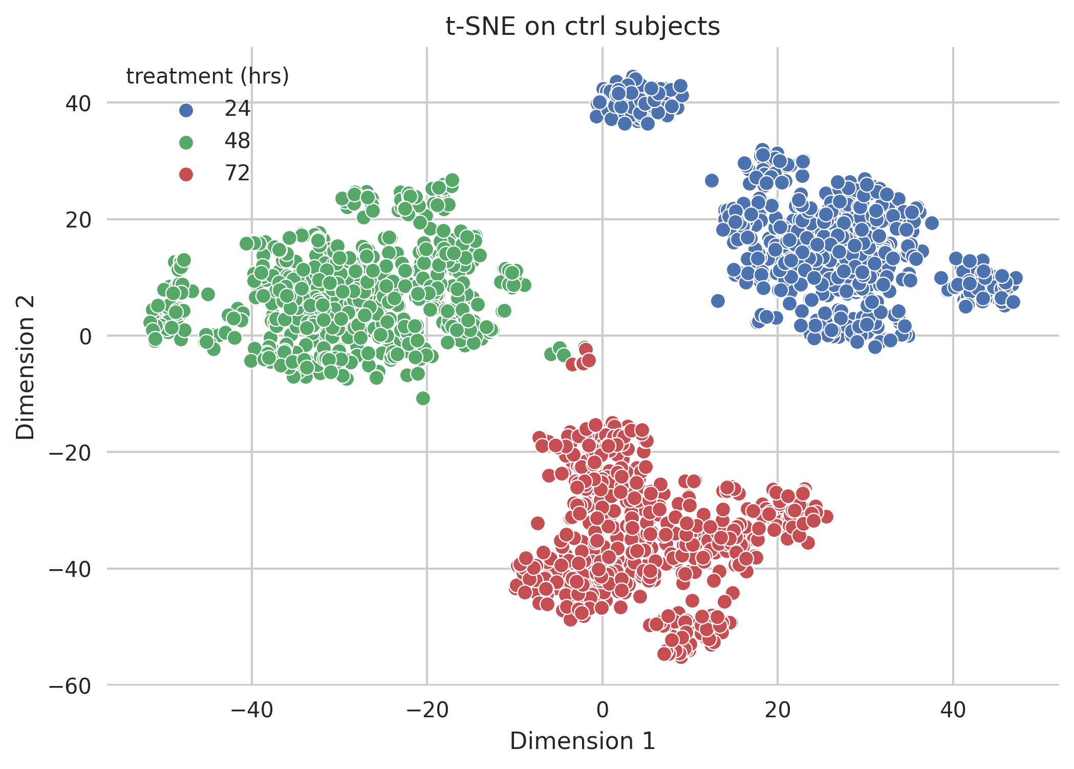
Dimensionality Reduction/Feature Extraction (cont.)
Why is there an effect if no drug is administered?

Slide 15
Implementation of Neural Network

Slide 16
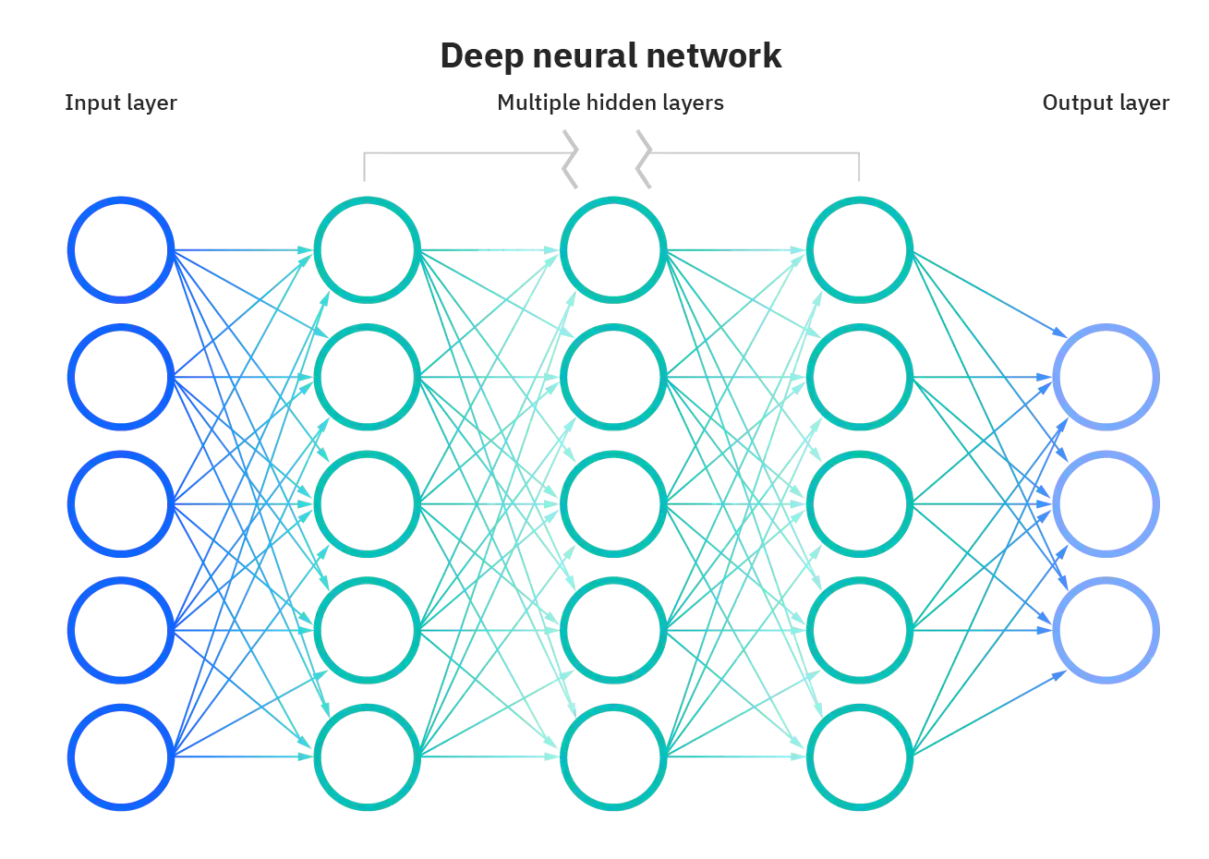
Inspired by architecture of human brain
Each “neuron” receives input from other neurons (in the form of weights), processes them using an activation function, and produces output
Essentially a nonlinear statistical model
Notes:
REWORD

Slide 17
NN architecture and parameters
Input layer = # features ~ 870
1st hidden layer – 1024 nodes, dropout = 0.2
2nd hidden layer – 1024 nodes, dropout = 0.5
Output layer = # MoA ~ 206, dropout = 0.5
ReLU activation in hidden layers, sigmoid for output layer
Binary Cross-Entropy Loss
# X-val folds = 4
# Epochs = 4
# Starts = 4
Batch Size = 128
Using PyTorch

Slide 18
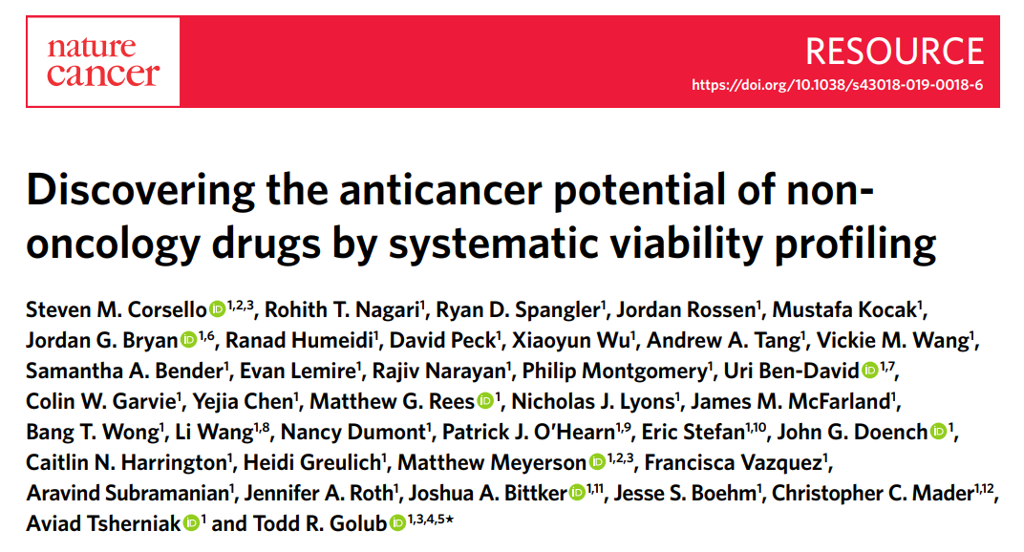
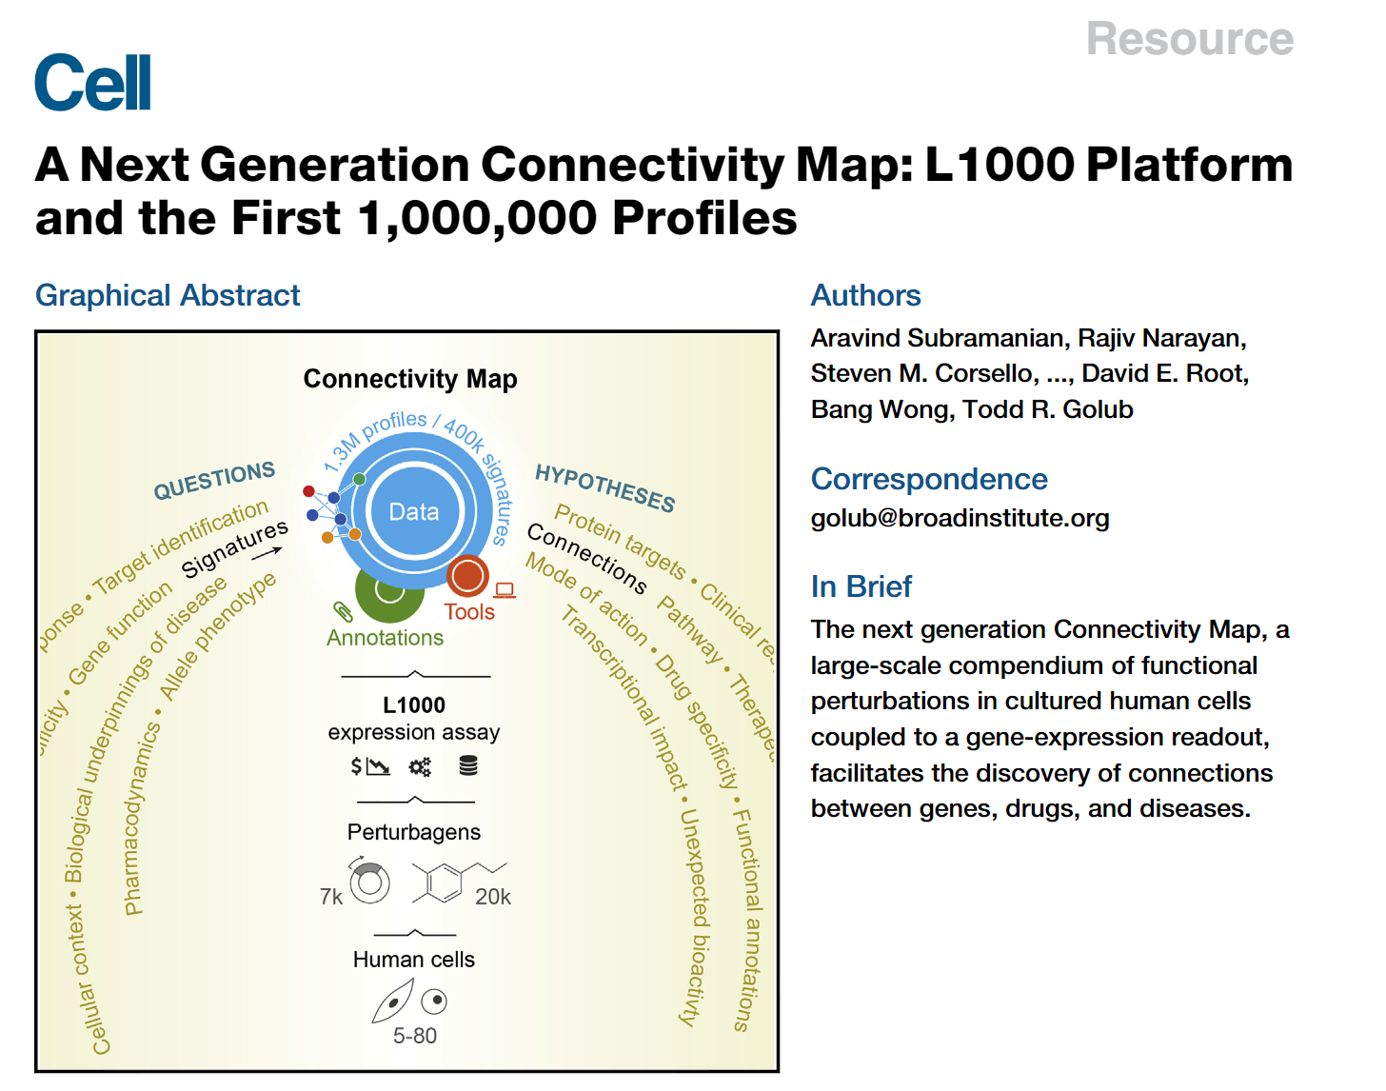
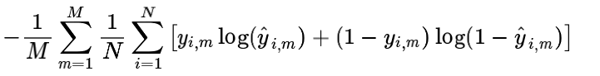
Results
My Score: 0.01985
Best Score: 0.01777
Average Score: ~0.019-0.021

Slide 19
Brainstorming

Slide 20
Points to Consider
Control subjects?
~8% of dataset
Clear PCA separation for treatment duration
Implications?
Not able to accurately predict MoA with little subjects
Negative impact on score if excluded

Slide 21
Learn more about ML!
Dig deeper into some features
Investigate treatment intensity (high vs low)
Use other ML techniques (e.g. support vector machines, random forests)
Improve neural network
Optimizing hyperparameters
Changing architecture
Image representation of data to use CNN
White paper describing design flaws
Other data analysis projects at Gilead?
Future Directions

Slide 22
Thank you Any questions?

